Slide 1
Fuzzy Logic In AI
Prof. Dr. A K M Akhtar Hossain
Dept. of CSE, RU

Slide 2
What is Fuzzy Logic?
Fuzzy logic is a form of many-valued logic in which the truth values of variables may be any real number between 0 and 1, considered to be "fuzzy".
In Boolean logic, the truth values of variables may only be 0 or 1, often called "crisp" values.
Fuzzy logic has been employed to handle the concept of partial truth, where the truth value may range between completely true and completely false.
Furthermore, when linguistic variables are used, these degrees may be managed by specific (membership) functions.
© Prof. Dr. A K M Akhtar Hossain Dept. of CSE, RU

Slide 3
Fuzzy logic
Fuzzy logic is a branch of fuzzy set theory, which deals with the representation and inference from knowledge. Fuzzy logic, unlike other logical systems, deals with imprecise or uncertain knowledge.
In this narrow, and perhaps correct sense, fuzzy logic is just one of the branches of fuzzy set theory.
© Prof. Dr. A K M Akhtar Hossain Dept. of CSE, RU

Slide 4
Fuzzy Applications
  Topology;
  Linguistics;
  Automata theory;
  Game theory;
  Pattern recognition;
  Medicine;
  Law;
  Decision support;
  Information retrieval; etc.
© Prof. Dr. A K M Akhtar Hossain Dept. of CSE, RU

Slide 5
Fuzzy Logic History
The term fuzzy logic was introduced with the 1965 proposal of fuzzy set theory by Lotfi A. Zadeh.
© Prof. Dr. A K M Akhtar Hossain Dept. of CSE, RU

Slide 6
Example:
Words like young, tall, good, or high are fuzzy.
There is no single quantitative value which defines the term young.
For some people, age 25 is young, and for others, age 35 is young.
The concept young has no clean boundary.
Age 1 is definitely young and age 100 is definitely not young;
Age 35 has some possibility of being young and usually depends.
on the context in which it is being considered.
© Prof. Dr. A K M Akhtar Hossain Dept. of CSE, RU

Slide 7
Fuzzy set theory
Fuzzy set theory is an extension of classical set theory where elements have varying degrees of membership.
A logic based on the two truth values, True and False, is sometimes inadequate when describing human reasoning.
Fuzzy logic uses the whole interval between 0 (false) and 1 (true) to describe human reasoning.
© Prof. Dr. A K M Akhtar Hossain Dept. of CSE, RU

Slide 8
A Fuzzy Set
A Fuzzy Set is any set that allows its members to have different degree of membership, called membership function, in the interval
[0 , 1].
The degree of membership or truth is not same as probability;
fuzzy truth is not likelihood of some event or condition.
fuzzy truth represents membership in vaguely defined sets;
© Prof. Dr. A K M Akhtar Hossain Dept. of CSE, RU

Slide 9
Fuzzy logic
Fuzzy logic is derived from fuzzy set theory dealing with reasoning that is approximate rather than precisely deduced from classical predicate logic.
Fuzzy logic is capable of handling inherently imprecise concepts.
Fuzzy logic allows in linguistic form the set membership values to imprecise concepts like "slightly", "quite" and "very".
Fuzzy set theory defines Fuzzy Operators on Fuzzy Sets.
© Prof. Dr. A K M Akhtar Hossain Dept. of CSE, RU

Slide 10
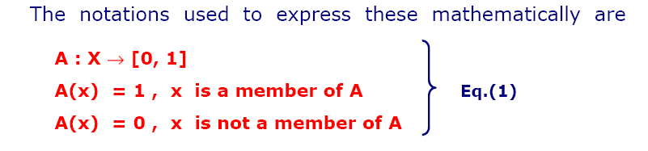
Crisp and Non-Crisp Set
© Prof. Dr. A K M Akhtar Hossain Dept. of CSE, RU

Slide 11
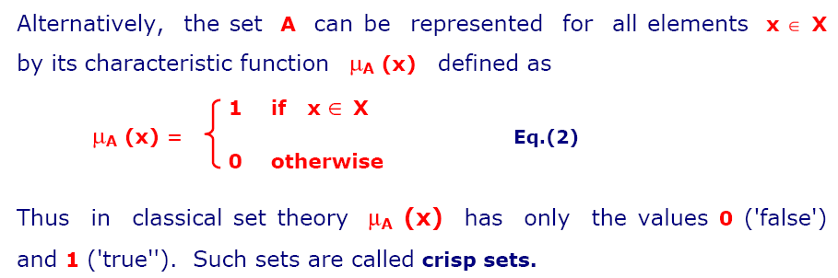
Crisp and Non-Crisp Set
© Prof. Dr. A K M Akhtar Hossain Dept. of CSE, RU

Slide 12
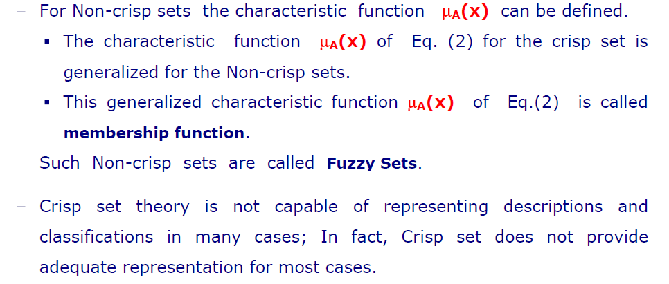
Non-Crisp Set
© Prof. Dr. A K M Akhtar Hossain Dept. of CSE, RU

Slide 13
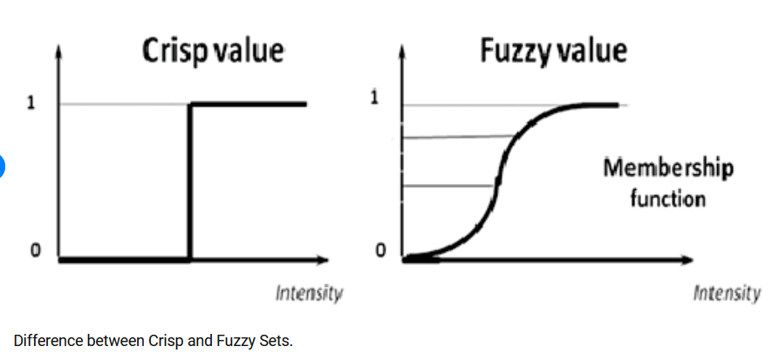
Crisp and Non-Crisp Value
© Prof. Dr. A K M Akhtar Hossain Dept. of CSE, RU

Slide 14
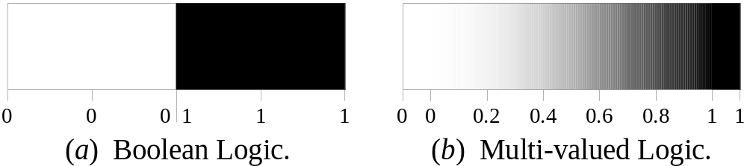
More Definitions (On Fuzzy Logic)
Fuzzy logic is a set of mathematical principles for knowledge representation based on degrees of membership.
Unlike two-valued Boolean logic, fuzzy logic is multi-valued. It deals with degrees of membership and degrees of truth.
Fuzzy logic uses the continuum of logical values between 0 (completely false) and 1 (completely true). Instead of just black and white, it employs the spectrum of colours, accepting that things can be partly true and partly false at the same time.
26th September 2006
Bogdan L. Vrusias © 2006

Slide 15
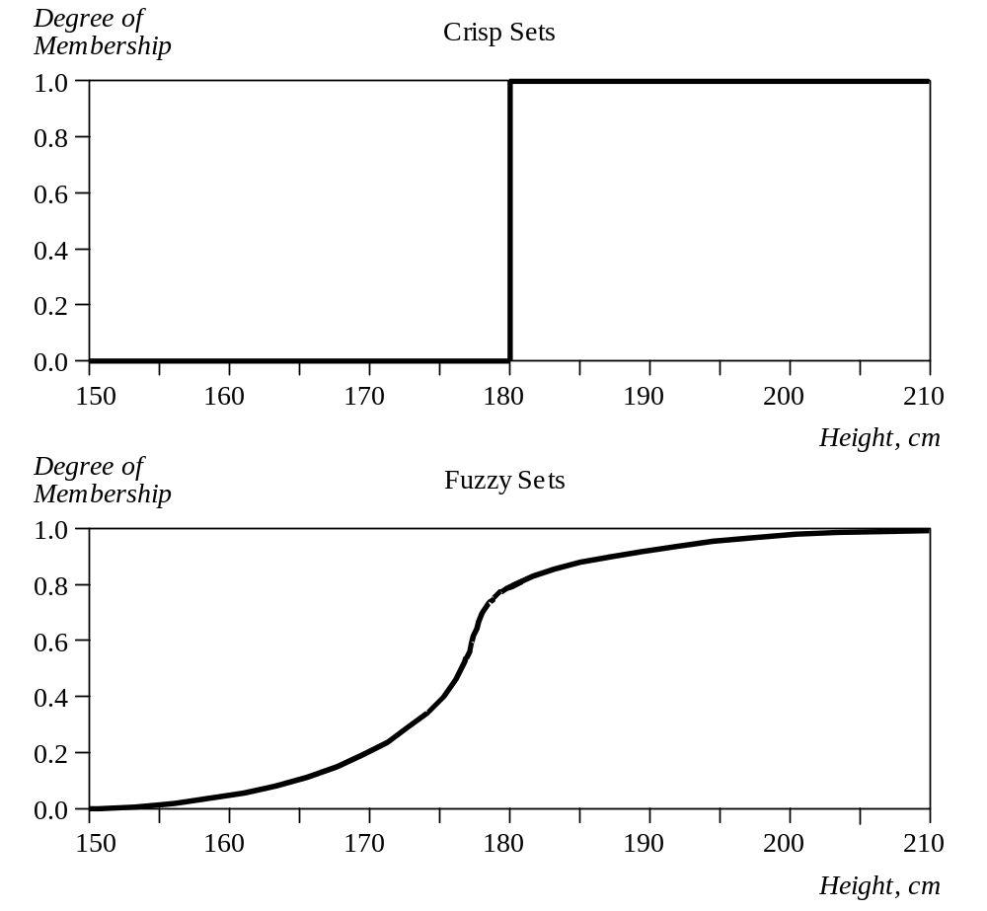
Crisp Vs Fuzzy Sets
The x-axis represents the universe of discourse – the range of all possible values applicable to a chosen variable. In our case, the variable is the man height. According to this representation, the universe of men’s heights consists of all tall men.
The y-axis represents the membership value of the fuzzy set. In our case, the fuzzy set of “tall men” maps height values into corresponding membership values.
26th September 2006
Bogdan L. Vrusias © 2006

Slide 16
Example: Fuzzy Sets
Hard science with IF-THEN rules
For example, the logic for a simple temperature regulator that uses a fan might look like this:
© Prof. Dr. A K M Akhtar Hossain Dept. of CSE, RU

Slide 17
IF temperature IS very cold THEN stop fan
IF temperature IS cold THEN fan speed is zero
IF temperature IS warm THEN fan speed is moderate
IF temperature IS hot THEN fan speed is high
© Prof. Dr. A K M Akhtar Hossain Dept. of CSE, RU

Slide 18
Characteristics of Fuzzy Logic
Following are the characteristics of fuzzy logic:-
This concept is flexible and we can easily understand and implement it.
It is used for helping the minimization of the logics created by the human.
It is the best method for finding the solution of those problems which are suitable for approximate or uncertain reasoning.
© Prof. Dr. A K M Akhtar Hossain Dept. of CSE, RU

Slide 19
Characteristics of Fuzzy Logic
It always offers two values, which denote the two possible solutions for a problem and statement.
It allows users to build or create the functions which are non-linear of arbitrary complexity.
In fuzzy logic, everything is a matter of degree.
In the Fuzzy logic, any system which is logical can be easily fuzzified.
It is based on natural language processing.
© Prof. Dr. A K M Akhtar Hossain Dept. of CSE, RU

Slide 20
Characteristics of Fuzzy Logic
It is also used by the quantitative analysts for improving their algorithm's execution.
It also allows users to integrate with the programming.
© Prof. Dr. A K M Akhtar Hossain Dept. of CSE, RU

